Slide 1
Safety Leadership
Tisha Nelson, CSP

Slide 2
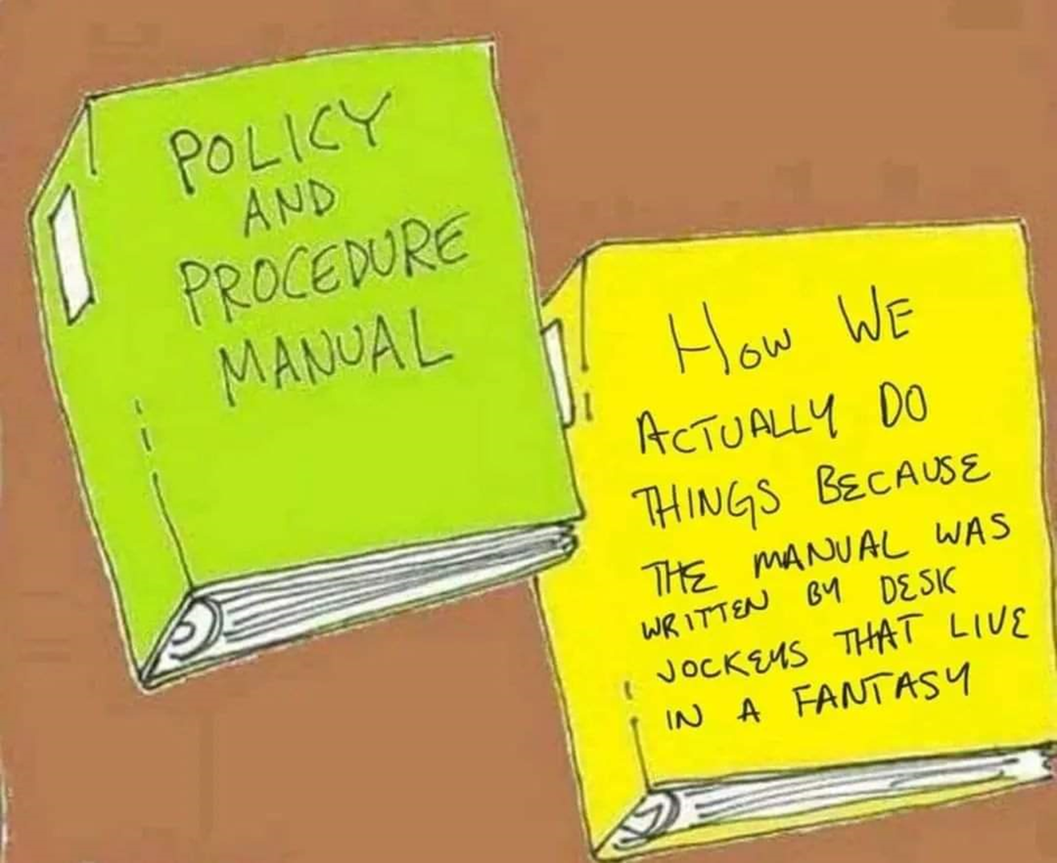
Notes:
Throughout my career, I’ve often been asked what the key to success in safety is. Like many things in life, there is no “silver bullet” or “cure all” that will solve safety issues once and for all. Lots of elements combine to create a world class safety program. But if I had to select one key ingredient that is necessary for success in safety in any industry, it would be leadership.
Many employers have 2 different policy and procedure manuals. Some of these employers don’t even realize they have 2 different safety manuals. Have you ever worked somewhere like this?

Slide 3
Safety Leadership
“Leadership is infinitely more important than policy, for the leader through his or her actions and decisions sends clear messages to the organization which policies are important, and which are not.”
- Dr. Dan Peterson
Notes:
Dr. Dan Petersen was one of the greatest contributors to the safety management and human performance improvement fields. He’s written many excellent books on the subjects.

Slide 4
Overview
Benefits of safety leadership
Leadership styles
Motivating employees

Slide 5
Benefits of Safety Leadership
Higher employee engagement
Companies with high employee engagement experience 62% fewer safety incidents
Engaged employees are 5 times less likely to suffer a safety incident.
Increase
Trust
Motivation
Productivity

Slide 6
Notes:
Leaders typically adopt one of three main leadership styles: 1) transformational 2) transactional and 3) servant. Each style has its time and place with none being good or bad. It is how leaders use them that determines success or failure. Transformational leaders shape and transform company culture by knowing where they want to go and doing everything possible to make it happen. Transactional leaders embed the culture into an organization by rewarding or punishing defined performance. Servant leaders sustain company culture by facilitating others’ needs to help them do their job properly.
Transformational leaders visualize, describe, and direct in ways that motivate others to act. They describe the conditions necessary for success and encourage employee participation to achieve collective goals. Creating a strategy to achieve the vision, they diagnose the issues and develop a strategic plan with measurable milestones to address them. They speak positively to sell the benefits and help employees identify with the company’s vision. They promote a can-do attitude among employees. They challenge and question prevailing assumptions, seek to drive change, and move people beyond their own limitations.
Transactional leaders clarify the relationships between performance requirements and desired outcomes. They consider followers to be responsible for their work and use performance monitoring with consequences (job promotions & pay raises and disciplinary action) to reinforce people’s behavior.
Servant leaders build personal relationships and convey support to individual group members through encouraging dialog and open communication. Servant leadership is about setting people up for success by facilitating their needs and showing concern for others. Servant leadership is a significant predictor of followers’ trust in their direct leader.

Slide 7
Servant Leadership
“I slept and dreamed that life was joy. I woke and found that life was service. I served and found that service is joy.”
- Rabindranath Tagore, Indian Saint and poet

Slide 8
Motivation
Increase Productivity/ Profitability
Improve Morale
Fewer Injuries
Improve Morale
Behavior
Motivation
Notes:
Motivation is the foundation of success. Effective safety leadership is known to be financially beneficial to a company’s bottom-line performance. It positively affects employees’ safety behavior and attitudes, boosts morale, helps reduce injury rates and insurance premiums, and contributes to increased productivity. Operational and safety excellence go hand-in-hand. Companies that are good at managing safety also manage operations well.

Slide 9
Satisfaction vs. Motivation
Money
Status
Work Relationships
Working Conditions
Satisfaction
Recognition
Authentic Leadership
Responsibility
Achievement
Potential for Promotion
Potential for Growth
Motivation
Notes:
What shifts an employee from doing the bare minimum to going out of their way to ensure the safety of themselves and others? Motivation! What motivates an employee? Leadership!
When employees meet expectations, they are rewarded with continued employment and a paycheck. That’s transactional leadership. Having a job and a paycheck often gives a person a sense of satisfaction. Having friends at work and good working conditions also leads to satisfaction.
Motivation is that drive to affect change, to move people beyond merely being satisfied. Leadership uses the leverage of motivation to change people’s behavior. Now we’ll get into some things that can move employees from satisfaction to motivation: recognition, responsibility, authentic leadership, and achievement.

Slide 10
Motivation
Notes:
In companies around the world, workers are feeling the effects of a highly addictive chemical. When they experience a reduction of this chemical, even routine work is compromised by feelings of frustration, anxiety, and difficulty in learning. Conversely, increases of this chemical stimulate feelings of pleasure and pride. And this chemical's effects wear off fast. The need for increased doses can cause people to make serious, career-altering decisions just to get another hit. And the only problem is that too few of us have enough. Anyone have any guesses as to what this chemical is?
This chemical is dopamine, a neurotransmitter produced in the brain. Dopamine stimulates the parts of the brain that process rewards and create positive emotions. There are several ways to get dopamine flowing. One thing that does it is receiving praise. Recognition for good work releases dopamine in the brain, which creates feelings of pride and pleasure. When we receive recognition, we get a hit of dopamine and that hit cements the knowledge that more of that behavior will create more praise, resulting in another dopamine hit, and so on. This is why positive reinforcement works so well.

Slide 11
Recognition
Fewer than 1 in 3 American workers can strongly agree that they’ve received any praise from a supervisor in the last 7 days.
Variation in response to the Q12 item "In the last seven days, I have received recognition or praise for doing good work" is responsible for a 10% to 20% difference in revenue and productivity.
Employees who report that they're not adequately recognized at work are three times more likely to say they'll quit in the next year.
Research
from
Notes:
Gallup has done some great research on praise. If you’re not familiar with Gallup, they are a global analytics and advice firm that helps leaders and organizations identify opportunities and develop strategies to increase employee engagement. They have over 80 years of data collection and have nearly 43 million respondents from 160 countries in their employee engagement database. Many employers, including WSI, use Gallup’s Q12 Employee Engagement Survey. One of the questions on the survey is IN THE LAST SEVEN DAYS, I HAVE RECEIVED RECOGNITION OR PRAISE FOR DOING GOOD WORK. Employees answer the question using a sliding scale answer from strongly disagree to strongly agree.
According to Gallup, fewer than 1 in 3 American workers can strongly agree that they’ve received any praise from a supervisor in the last 7 days. 7 days seems like a short time frame but the dopamine bump people get from praise doesn't last very long, and it takes repeated exposure to build the reward/repeat loop. An annual pat on the back doesn't feed emotional engagement. People need a day-to-day feeling of being appreciated and recognized for what they do.
Variation in response to the Q12 item "In the last seven days, I have received recognition or praise for doing good work" is responsible for a 10% to 20% difference in revenue and productivity. Imagine what kind of increase you could get in safe work habits from recognition alone. And giving praise costs nothing. Employees who report that they're not adequately recognized at work are three times more likely to say they'll quit in the next year.

Slide 12
Giving Praise
No “best” form
Varies by person
Ask before praising in public
Ask employees what they prefer
Must be warranted, sincere, and genuine
Address the behavior not the person
Praise individuals and the group
Start low key at first
Notes:
There is no “best” form of praise. Different employees have different preferences. Some people want to be praised publicly and others might be embarrassed by that kind of recognition, so it’s important to know your employees. If you want to find out what kind of praise is most appreciated by your employees, ask them.
No matter the method, praise should be warranted and sincere. If recognition isn’t warranted, it can quickly lose its meaning. Be specific about what the recognition is for. Tie it to a behavior or an action. Avoid generic praise like “you’re a good worker”.
Teams should also be recognized as a whole for great performance. This will help individuals identify with the group and builds bonds that make them feel good about the team. Publicly recognizing whole departments for the value they add to the organization increases employee engagement.
If you haven’t been free with your praise until now, it’s better to start low key. In workgroups starved for praise, the first applications of it may inadvertently create some bitterness or resentment. You don’t want to start by publicly recognizing one team member. A good way to start with your employees is a one-on-one approach.

Slide 13
Authentic Leadership
Do you care?
Can I trust you?
Notes:
Authentic Leadership is the impression given that the leader is authentic in their behaviors. It inspires followers to achieve at higher levels.
One of the greatest mentors of my career gave me some of the best advice. He said that to be a successful leader, employees need to be able to answer “yes” to these two questions.
Trust is an important leadership trait that is established by being authentic as a leader. The ability to increase trust levels can increase worker motivation and the desire to work safely.

Slide 14
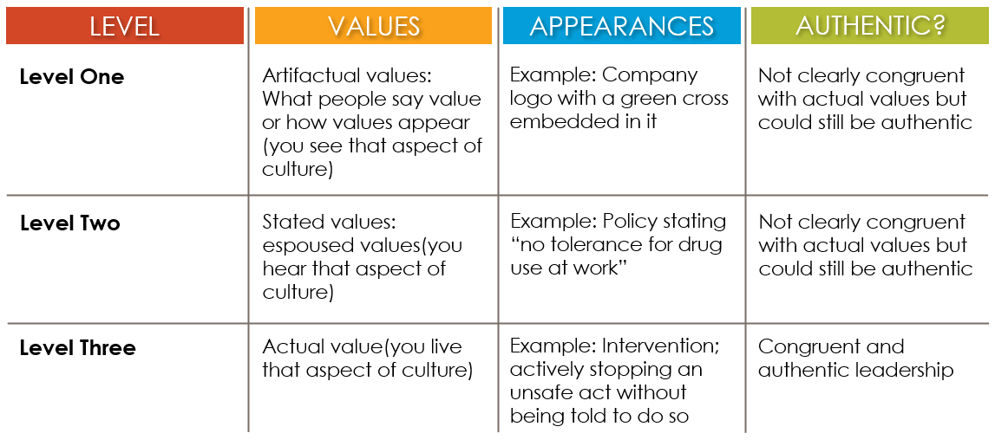
Schein’s Levels of Culture
Notes:
Authentic safety leadership is more than just saying “we have core values” and one of them is safety. Schein’s research identifies three levels by which to evaluate an organization’s adherence to its core values. An authentic leader displays all three levels. It’s not enough to list safety as a core value and print it in a handbook or post it on the company website. Unless a company can develop and display all three levels of culture, then having a safety culture or core safety values is just talk. In level one, we have artifactual values. Our values are posted on the wall or the website. We can see what they are.
In level two we have stated values. Our values are expressed in our policies and procedures. But what is written in our policies is not always what happens in real life. We might have a new employee in training with a seasoned employee who hears “Now, the policy says XYZ, but let me show you how it’s really done.” We must make sure we live by our values. Every time a supervisor walks past an unsafe act and ignores it, the safety policy gets rewritten.
In level three, what we see, say, and do all matches. Everyone agrees on the values and lives by them. Employees are empowered and motivated to actively stop unsafe work on their own. There is a culture of actively caring for one another’s safety as well as our own.
A couple of weeks ago, I had the opportunity to see a great example of level three in action. I was driving back from an audit in Fargo and I saw two workers on a roof of a business. They had fall protection on which is something that we don’t see enough of in roof work. So, I stopped to say thank you and good job to the workers. They were behind a fenced in area of the property that wasn’t open to the public, so I went in to the office and introduced myself. I mentioned the guys on the roof and their fall protection. The lady in the office told me that the contractors showed up to work on the roof and didn’t have any fall protection with them. So, she made sure to provide it to them and made sure that they were wearing it. She stepped in to intervene without being told to do so to protect workers that don’t even work for that company. That is congruent and authentic safety leadership in action!

Slide 15
Authentic Leadership
Self-Awareness
Balanced Processing
Relational Transparency
Internalized Moral Perspective
Notes:
Authentic leadership can be defined through 4 factors: self-awareness, balanced processing, relational transparency, and internalized moral perspective.

Slide 16
Authentic Leadership
Self Awareness
Use journaling/self-narratives to know yourself better
Seek feedback from others including direct reports
Understand how others view you
Show understanding of how your actions impact others
Solicit candid feedback from employees on how you handle safety issues
Notes:
360 degree feedback surveys

Slide 17
Authentic Leadership
Balanced Processing
Solicit views that differ from your beliefs
Carefully analyze data
Listen to others before a decision is made
Look for safety incident causes rather than guilty employees.

Slide 18
Authentic Leadership
Relational Transparency
Say what you mean and mean what you say
Admit your mistakes
Encourage others to speak their mind
Tell the truth even when it’s hard.
Avoid hiding your true emotions.
Provide candid and constructive feedback and allow employees to explain their behavior.

Slide 19
Authentic Leadership
Internalized Moral Perspective
Show integrity
Make decisions that align with your core values and high ethical standards.
Encourage others to define their core values.
Prioritize employee safety over production even when personal objectives conflict with the decision.
Notes:
Do the right thing even if no one is looking. Higher performance in production could lead to bonus.

Slide 20
Notes:
What is the difference between values and priorities. Values stay the same no matter what. Priorities change. If you say that safety is your number one priority, I don’t believe that it is true all the time. Sometimes your priority is going to be customer service or productivity or meeting a deadline. But no matter what your top priority is at any given moment, safety should always remain a value.

Slide 21
Values
“Management commitment provides the motivating force and the resources for organizing and controlling activities within an organization. In an effective program, management regards workers’ safety and health as a fundamental VALUE of the organization and applies its commitment to safety and health WITH AS MUCH VIGOR as to other organizational purposes.”
- OSHA Safety and Health Program Management Guidelines

Slide 22
Leadership Walks
Be a problem finder
Identify hidden hazards
Note - This is not an audit or inspection
Identify & Embrace Problems
See problems as opportunities to learn and improve
Servant Leadership
“How can I better serve the safety needs of employees?”
Observe people, processes, successes, and issues
Ask lots of questions
Listen for understanding
Notes:
Great leaders observe, inquire, recognize patterns and reflect on lessons learned in their organizations. Try to do at least one a week.

Slide 23
Leadership Walks
How much do you know about your team?
Family?
Hobbies/interests? Favorite coffee?
Birthdays
Work Anniversaries
Ask great questions and really listen
Tips for connecting in conversation:
Here’s what I’m thinking….Interested in your thoughts about the issue
Tell me more about that….
How did that make you feel?
Understand the importance of communication
Smile, make eye contact, be present
LISTEN WITH YOUR HEART
Seek to understand others’ perspectives
Notes:
Great leaders observe, inquire, recognize patterns and reflect on lessons learned in their organizations. Try to do at least one a week.

Slide 24
Leadership Walks
Ask if this is a safe and convenient time
Open conversation on a personal note
Explain what you are doing
Recognize the positives
Ask what the major safety concerns are
Verify that hazard controls are in place and are working well
Provide candid and constructive feedback on unsafe acts/ conditions
Close on a positive note

Slide 25
Leadership Walks
Follow up
Make/delegate corrective actions
Communicate the status of actions taken or planned

Slide 26
Follow Up and Support
Close the loop
Fund safety adequately.
In all business decisions, seek to treat the safety of all employees as the ethical, right thing to do.
Notes:
Close the loop by including employees in the process so that they know and understand why some safety suggestions are implemented and why some are not. Makes employees more likely to report additional safety hazards and increase morale because employees feel heard.

Slide 27
Follow Up and Support
Notes:
When you have multiple hazards competing for the organization’s dollars, it can be hard to choose which ones are the most important. It can be helpful to calculate risk scores for each hazard to help prioritize what to do first. When looking at controls to implement, using a risk assessment matrix can also be helpful in determining whether the proposed control reduces the hazard to an acceptable level. If you’re interested in more quantitative risk-based methods used to justify costs to correct hazards, please let me or your safety consultant know.

Slide 28
Responsibility
Have employees help develop SMART goals
Break goals down into action plans
Assign tasks to employees
Notes:
Every employer in WSI’s Safety Management Program is required to develop proactive safety goals each year. A great way to give employees responsibilities and increase engagement is to have employees help develop those goals. Get your employees involved as you draft your goals and use the SMART goal setting process.
Specific - Clearly define desired outcome or results
Measurable - Establish concrete criteria to measure progress on attaining each objective.
Actionable - A goal should be translatable into actionable and concrete tasks.
Realistic - Make sure a goal is practical in terms of how applicable it is to the workplace, scope of the desired change, and its timeframes – or employees may not try to achieve them.
Time-Oriented - Set realistic time frames including start and end dates and milestones. Without time frames, employees may not have incentive to work towards goals, or if unrealistic, employees may be discouraged.

Slide 29
Responsibility
Provide opportunities for employees to participate in safety
Develop safety program
Set safety goals and KPIs
Hazard assessments
Hazard inspections
Safety suggestions
Develop/conduct safety training
Mentor new hires
Develop/review safe work procedures
Incident investigations
Exposure monitoring/surveillance
Program Evaluation
Notes:
Assigning safety program responsibilities to employees can increase motivation and engagement. There are many ways that you can get employees involved. Getting employees involved in these activities will also help increase buy in from employees. When employees are involved in developing the safety program, it becomes theirs and people will be more likely to do what they can to see that their program succeeds. Have you ever heard anyone talk about someone’s work product as their “baby”?

Slide 30
Achievement
What gets measured gets done
What gets celebrated gets done well
Measure more than just the results
Notes:
In many other processes besides safety, we measure both the inputs and the process itself to predict or influence the outcomes. If the inputs are measured and continually improved, then the outputs are more likely to yield desired results. Instead of measuring your performance with only lagging indicators like incidence rates or experience rating , use leading indicators that are based on action, activities, and progress along with your results.

Slide 31
Measuring Achievement
Collect the data
Periodically measure progress toward your goal and take action if you are not meeting it.
Communicate your progress with workers.
Periodically reassess your goals and indicators.
Notes:
If the leading indicators are going in the wrong direction, the right part of the organization needs to act. Don’t hold the safety person responsible for work orders not completed by maintenance. If employees are encouraged to submit safety suggestions, but management is not measured on the closure of the suggestions, soon meaningful employee participation will decline.
After tracking your indicator for a while, evaluate progress toward your goal and assess whether you have been meeting it. For some
indicators and goals, it can take longer to see progress. You should review it regularly, and consider whether you need more time to
assess its effectiveness.
Respond to what you learn from the results of your leading indicator, share the information with relevant personnel in your
organization and, when necessary, change your leading indicator based on what you learn.

Slide 32
Measuring Achievement
+
+
Weight
Staying
Under
Calorie Budget
Strength
Training
2x Per Week
=
Eating
5 Veggies
Per Day
Exercise
3x Per
Week
Loss
Notes:
For example, if I had a goal of losing weight, instead of measuring just the number of pounds I’ve lost, I would track how many servings of vegetables I had each day. Now, even if I do eat the recommended number of vegetable servings in a day, I would still need to make sure that I didn’t consume too many calories if I want to lose weight, so I would also keep track of my calories and whether I stayed within my calorie budget each day. Weight loss is also affected by physical activity, so I shouldn’t just keep track of my eating habits. I should also make sure I exercise regularly. So, I would also measure whether I’m meeting my self-imposed requirement to exercise three times per week. Also, I’ve heard that strength training can increase the number of calories I can burn while resting, so I’m going to make sure that at least two of my exercise sessions is strength training. If I do all the things I’m supposed to do, I should end up with the results that I want. If I am not getting the results that I want, I should be able to look back at my leading indicators and figure out where the problem is.

Slide 33
Measuring Achievement
+
=
Notes:
Let’s look at a safety example. Let’s say we are trying to reduce our lifting injuries. Our inputs could be completing job safety analyses, implementing ergonomic interventions, safe lift training, and ensuring that calls for help for team lift are answered within 5 minutes.

Slide 34
Effective Safety Leadership
Show that they genuinely care about people
Lead by example
Show appreciation
Listen to their followers and act on relevant information
Set clear direction for actions
Clarify expectations and responsibilities
Set and maintain improvement targets
Hold people accountable
Involve everyone in safety
Notes:
To recap, effective safety leadership looks like….

Slide 35
Remember…
True cultural change takes time.
You will achieve the level of safety excellence that you demonstrate you want.
Notes:
Change is not going to happen overnight. It requires making a commitment to change and seeing it through.

Slide 36
Questions?
Tisha Nelson, CSP
701-298-4984
tbnelson@nd.gov
workforcesafety.com

Slide 37
Thank you!

Slide 38
References
Avolio, B.J. & Gardner, W.L. (2005). Authentic leadership development: Getting to the root of positive forms of leadership. The Leadership Quarterly, 16(3), 315-338. https://doi.org/10.1016/j.leaqua.2005.03.001
Blair, E. (2021) Great leaders do not solve problems: moving from good to great leadership. Professional Safety Journal, August 2021.
Cooper, D. (2015). Safety leadership: understanding types & styles that improve safety performance. Professional Safety Journal, February 2015.
Esposito, P. (2021). Safety through accountability & recognition: OHSMS management commitment & worker participation explained. Professional Safety Journal 66(3).
Kath, L.M., Magley, V.J., & Marmet, M. (2010). The role of organizational trust in safety climate’s influences on organizational outcomes. Accident Analysis and Prevention, 42(5), 1488-1497. https://doi.org/10.1016/j.aap.2009.11.010.
OSHA. (1989). Safety and health program management guidelines: Issuance of voluntary guidelines. www.osha.gov/laws-regs/federalregister/1989-01-26
OSHA. (2019). Using leading indicators to improve safety and health outcomes. https://www.osha.gov/leading-indicators
Robison, J. (2006). In praise of praising your employees. https://www.gallup.com/workplace/236951/praise-praising-employees.aspx

Slide 39
References
Schein, E.H. (1992). Organizational Culture and Leadership
Sendjaya, S. & Pekerti, A. (2010). Servant Leadership as an antecedent of trust in organizations. Leadership and Organization Development Journal, 31(7), 643-663. https://doi.org/10.1108/01437731011079673
Walker, S. & Kuchinka, G.J. (2023). Authentic leadership & safety climate. Professional Safety Journal, August 2023.
Winn, G. (2014). Safety leadership: insights from military research. Professional Safety Journal, January 2014.

