Slide 1


2019 Safety & Health Conference
Making Safety
a Core Value
Ronn Lehmann
Notes:
Presented December 3, 2019 at the NRASP Annual Safety & Health Conference
Ronn Lehmann
612-353-7800
ronn@ronnlehmann.com
Website: www.ronnlehmann.com

Slide 2

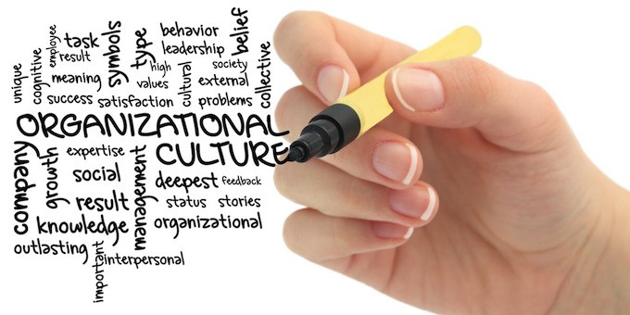
My Focus
Notes:
I focus on the Human Factors in work that create success…and sometimes failure.
I help organizations make sure their Culture supports their Core Values, the things that are important to them…like Safety, Quality, Productivity…and even making money.

Slide 3
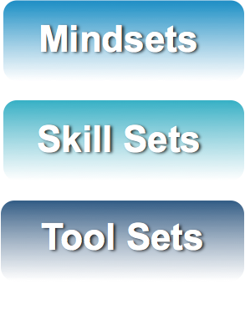
My Point Of View
Notes:
To be successful at anything, you need the right Mindset, Skill Set and Tool Set.
Of these, Mindset is the biggest determinant of success or failure.

Slide 4
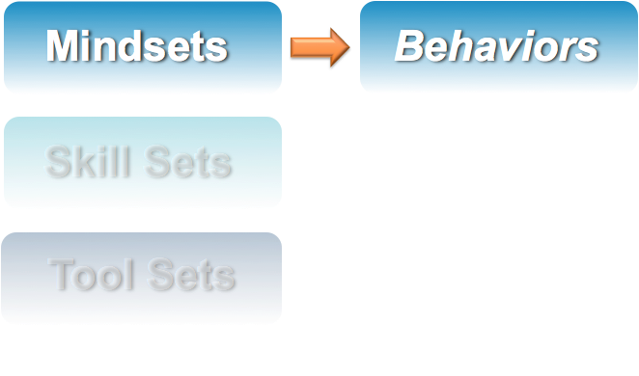
My Point Of View
Notes:
Mindsets drive Behaviors...
...so, if you want to change behaviors, you have to change Mindsets.

Slide 5
Reasons People Don’t Work Safely
Don’t know WHAT to do
Don’t know HOW
Don’t have the TOOLS
Don’t WANT to
Think they ARE
Don’t think they HAVE to

Slide 6
Reasons People Don’t Work Safely
Don’t know WHAT to do
Don’t know HOW
Don’t have the TOOLS
Don’t WANT to
Think they ARE
Don’t think they HAVE to
Notes:
Training usually only addresses the HOW issue. Of the other five, four are Mindset issues.

Slide 7
My Point Of View
Culture

Slide 8

What Is Culture?
Personality
Values
Assumptions
Behavioral Norms
Artifacts
Language
Symbols
Stories & Legends
Decision making
Daily work practices
Notes:
An organization’s Culture can be thought of as it’s “Personality”: how it’s experienced by Customers, Employees, Suppliers and the Community.
Culture is made up of Values, Assumptions, Behavioral Norms and Artifacts that are shared by individuals within the organization.
Culture is represented by Language, Decision Making, Symbols, Stories & Legends and Daily Work Practices.

Slide 9
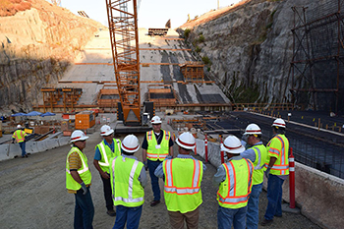
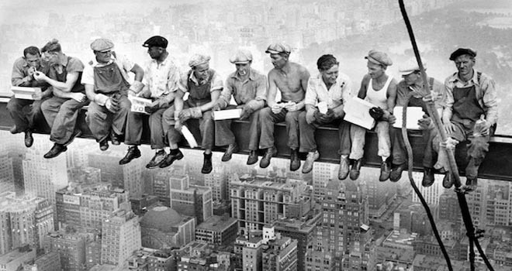
What Is Culture?
What’s Important
How People “Show Up”
Notes:
Simply put, an organization’s Culture is comprised of What’s Important and How People “Show Up”.

Slide 10
Culture Is…
Created by Individuals
Learned
More about “Soft Stuff”
Notes:
Culture is:
Created by individuals, not organizations.
Learned through what is rewarded and what is punished.
More about the so-called “soft stuff” of humans interacting with each other, vs. the “hard stuff” of interaction with “things” (systems, equipment, numbers, etc.).

Slide 11
The Value Of Values
=
Notes:
An organization’s Culture is comprised of its Values and those of the individuals working there: What’s Important and How People “Show Up”.

Slide 12
Examples Of Other Values
Autonomy Ask For Help
Bias for Action Make Money
Second Chances We Know Best
Notes:
Examples of other Values operating in organizations I have audited.

Slide 13

The Value Of Values
Culture 1st,
Size 2nd
What’s Right for Customers
People
Ethics
Leadership
Growth
Profit
Market Share
Stock Price
Cross-Selling
Notes:
On the left are the espoused Values of Wells Fargo. On the right are the apparent Values of Wells Fargo, as identified by investigations into their financial misdeeds.

Slide 14
The Value Of Values
Culture 1st,
Size 2nd
What’s Right for Customers
People
Ethics
Leadership
Growth
Profit
Market Share
Stock Price
Cross-Selling
Notes:
Wells Fargo’s apparent Values were not balanced by genuine attention to their espoused Values.

Slide 15


When Values Collide
PRODUCTIVITY
Notes:
If an organization values both Safety and Productivity, what happens when they collide?
If Productivity wins, it can lead to cutting corners on Safety and taking risks.
If Safety wins, it can lead to schedule delays and budget problems.

Slide 16
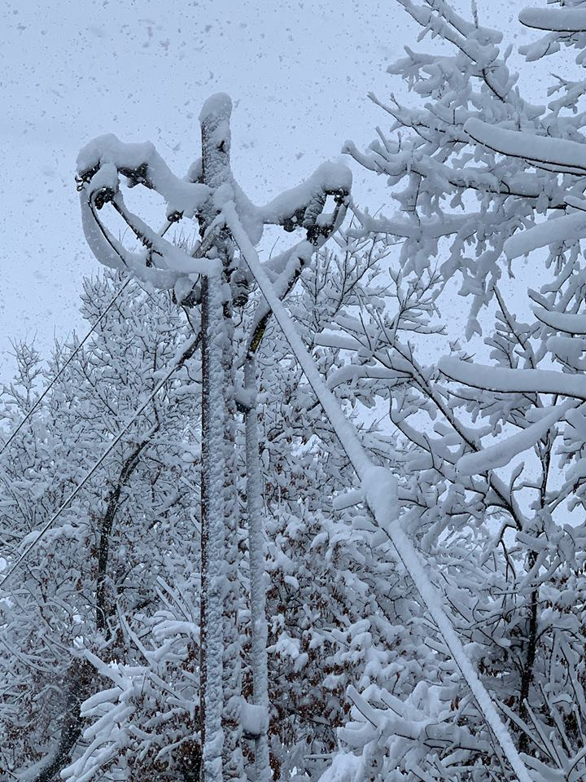
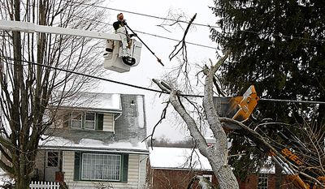
When Values Collide
Notes:
While trying to restore power after an ice storm, a lineman was faced with a collision of Values:
The Value of Safety said to follow the rules and stop working when it got dark.
The Value of Productivity said to keep working and restore power for more customers.

Slide 17
When Values Collide
Profits
People
Quality
Customer
Focus
PRODUCTIVITY
Integrity
Notes:
When you add in an organization’s other Values, the collisions are multiplied.

Slide 18
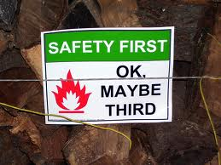
When Values Collide
Notes:
And that’s how Safety can be pushed down on the priorities list.

Slide 19

Safety As A Core Value
Safety
Notes:
In a True Culture of Safety, Safety is a Core Value of the organization.

Slide 20

Safety As A Core Value
SAFETY!!
Notes:
When Safety is a Core Value, it is continuously communicated:
Part of every conversation, meeting, phone call, e-mail
Safety questions are asked; not “gotcha” but to hear what others have to say.
All communication avenues are used, including stories, artifacts and symbols.

Slide 21
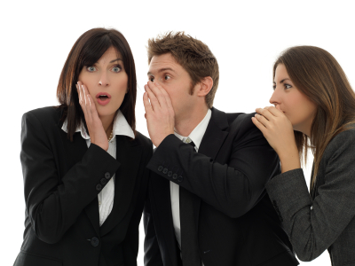
Safety As A Core Value
The Rumor Mill
Notes:
An effective (and often overlooked) communication tool is the Rumor Mill: use it to spread good rumors about Safety.

Slide 22

Safety As A Core Value
Notes:
When Safety is a Core Value, Leaders live Safety: they make Safety a priority by showing it’s important, and they behave safely themselves.

Slide 23

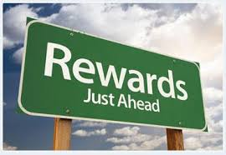
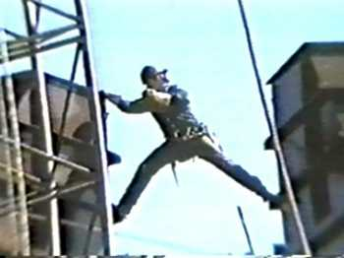
Safety As A Core Value
X
Notes:
When Safety is a Core Value, it is reinforced by recognizing and rewarding safe mindsets and behaviors.
And unsafe mindsets and behaviors are addressed and people are held accountable.

Slide 24
Safety As A Core Value
Productivity
Quality
Leadership
Customer
Focus
Safety
Continuous
Improvement
Efficiency
Integrity
Notes:
When Safety is a Core Value, it is an integral part of all operations.
Safety is used as a compass to guide decision making.
Safety goals are created and measured, and action is taken to achieve them.

Slide 25

Safety As A Core Value
≠
Safety
Notes:
Not having accidents is not proof that Safety is a Core Value...it might just be luck.

Slide 26

Hazards To Your Culture
CULTURE
AT RISK!
Notes:
Even if you have a good Safety Culture, it requires constant care and feeding. Left unattended, Cultures never get better; they only get worse.
Your Safety Culture is always at risk. Times of growth and success can cause a dilution of the Culture, the creation of “thermal layers” of management and disconnects with new hires. Down times can challenge employees’ beliefs in your Values and trust in leadership.

Slide 27

Hazards To Your Culture
DANGER!
Disengagement
Doing just enough to get by
Not taking the initiative
Taking Safety shortcuts
Accepting lower standards
Notes:
Complacency is a risk to a Safety Culture—even if Safety is a Core Value.

Slide 28
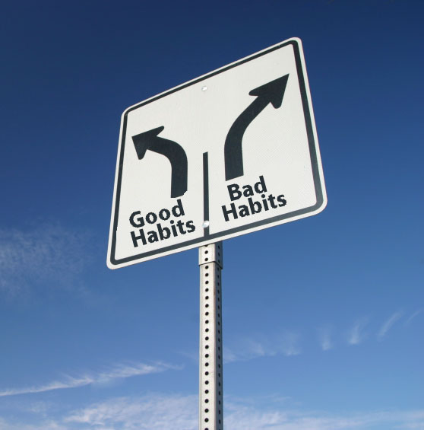

Hazards To Your Culture
Notes:
Habits are also a hazard to a Safety Culture. Some habits are good, some are not so good. We need to know which ones are which by being mindful and making conscious choices.

Slide 29
So, Now What?
Hmmm…

Slide 30

Right Away…
Notes:
Check out your Mindset and Values:
Is Safety a Core Value for you?
Does Safety have trump over other Values?
Do you use Safety to guide your decisions?
What do you demand? What do you tolerate?

Slide 31

Right Away…
Notes:
Check out how you Communicate:
Make Safety part of every conversation, meeting, phone call, e-mail…and if you “Tweet”, tweet about Safety.
Ask Safety questions (not “gotcha” but to hear what others have to say).
When you’re sure you’ve communicated enough, keep communicating!

Slide 32

Under-Communicating
The Four S’s
Safety
Schedule
$$$
Satisfied Client
Notes:
Example of a CEO’s Values that were not evident in the Culture.

Slide 33
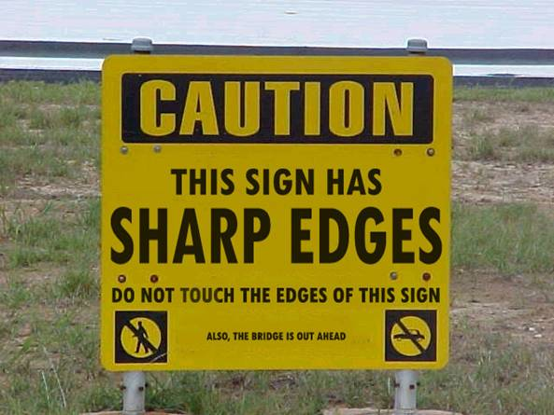

Right Away…
Notes:
And make sure you always communicate what’s most important.

Slide 34
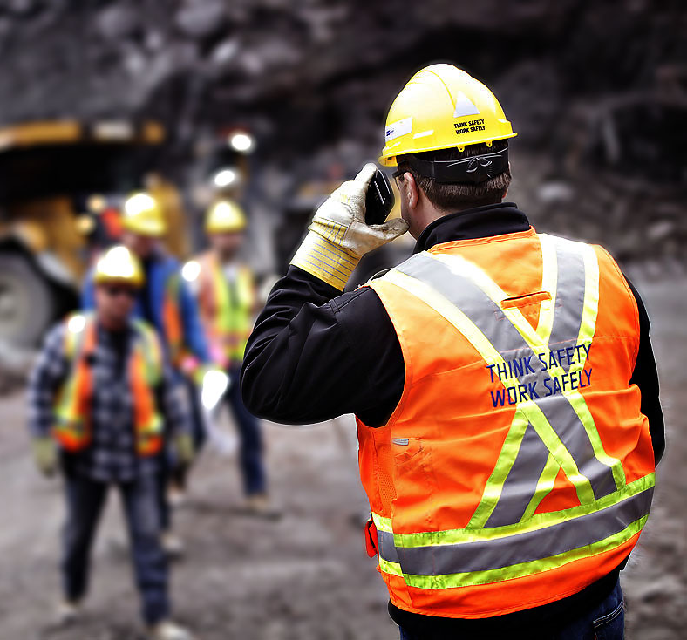
Right Away…
Notes:
Check out how you Show Up:
People watch what their Leaders do more than they listen to what they say, so communicate that Safety is a Core Value through your actions as well as your words.
Reward and reinforce safe mindsets and behaviors.
Don’t tolerate unsafe mindsets and behaviors–take action.
Be Authentic and Live your Values.

Slide 35

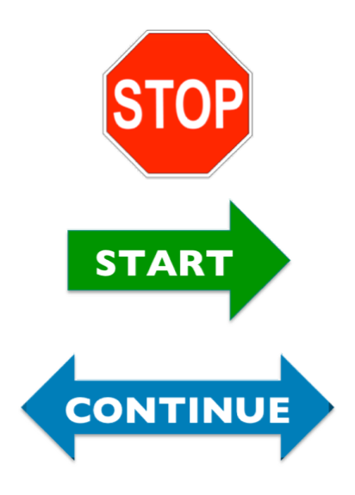

And In Conclusion…
Notes:
Don’t wait to take action:
Identify one thing you will:
☛ STOP doing
☛ START doing
☛ CONTINUE to do
Share your experience and what you learned.

Slide 36

Notes:
It’s your turn at bat, so make a difference!

Slide 37



Thanks!
Ronn Lehmann
ronn@ronnlehmann.com
612-353-7800
www.ronnlehmann.com
Notes:
Thanks for attending our session, and if I can be of value to you and your organization, please contact me.

