Slide 1
FMCSA ELDT
February 7, 2022
Notes:
Welcome everyone, I was asked to present the FMCSA ELDT today.

Slide 2
Agenda
Border States
Background
Commercial Vehicles
Commercial Drivers License
Interstate Commerce
The Driver Training Opportunity
Entry Level Driver Training before February 7, 2022.
Notes:
Our agenda for the next six hours.

Slide 3
Agenda
Entry Level Driver Training after February 7, 2022
FMCSR implied CMV driver training
Current litigation trends
Vectors to trouble
Notes:
Questions before we begin. I would like to keep this interactive.

Slide 4
Border States OVERVIEW
Notes:
Border States has approximately 1200 assets deployed from 25 States.

Slide 5
MRO Demo Trucks
On-site training and demonstrations

Slide 6
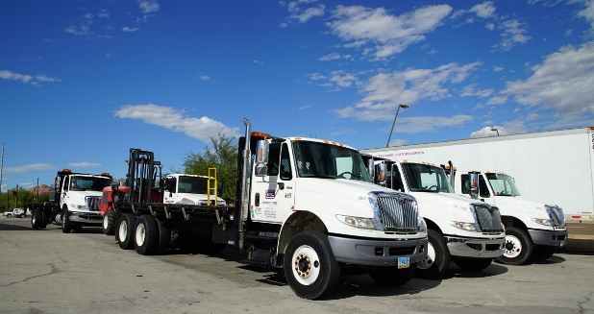
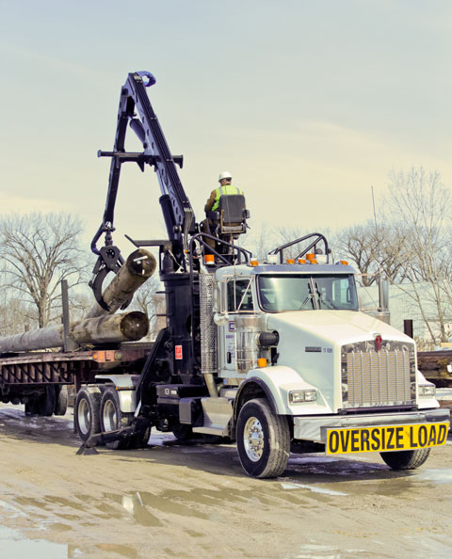
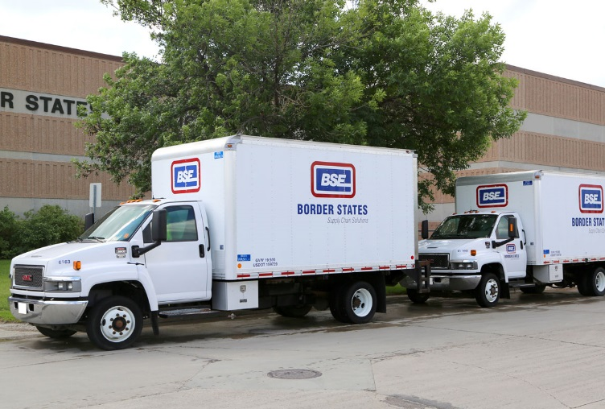
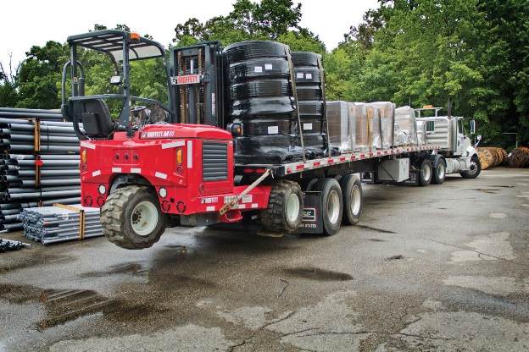
Delivery FLEET
Notes:
Border States operates everything from delivery vans to utility pole trucks. We will deliver your triple A batteries or your 110 ft. utility pole. We operate many laydown yards for several utilities and their contractors.

Slide 7
Delivery FLEET
Notes:
We also have several OTR vehicles that spend one to 4 nights on the road.
We have approximately 540 drivers across our footprint.

Slide 8
Ron Rosenthal
30 years of distribution experience in various roles.
Owner / operator for multiple years.
Personally trained approximately 18 CDL A driver’s being in 1999
Partnered with CDL schools to train about 50 more CDL drivers.
Trained Long Combination Vehicle Drivers.
Notes:
Various roles through the years delivery driver to VP Ops. One role always stuck in must of my roles, Driver Training. I started training drivers for their CDL in 1999, quickly learned that I was not going to fill the driver shortage by myself. Started partnering with true truck driver training schools.

Slide 9
Long Combination Vehicles

Slide 10
Fleet Safety Specialist
Focused on the overall fleet compliance and operating risk reduction.
Create and/or provide driver training for initial onboarding, transitional or remedial opportunities.
Audit DOT fleet compliance, identify gaps and implement improvements.

Slide 11
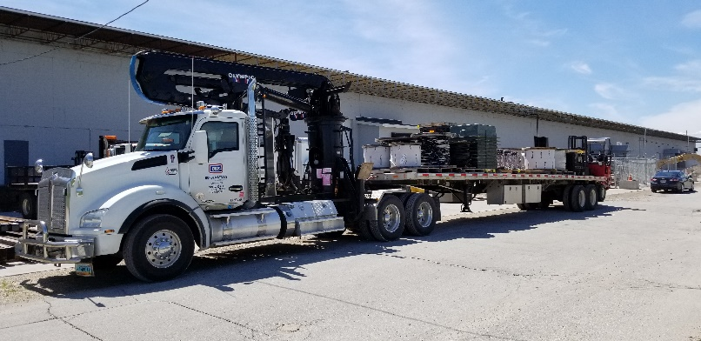
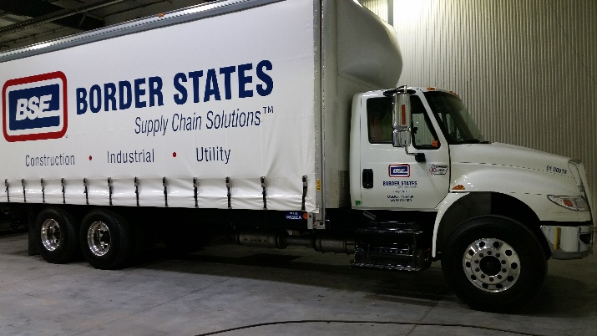
What is FMCSA ELDT
Federal Motor Carrier Safety Administration – Entry Level Driver Training for Commercial Drivers License. Initial Training for-
Commercial Driver Class A (CDL A)
Commercial Driver Class B (CDL B)

Slide 12
What is FMCSA ELDT
Initial Training for-
Passenger Endorsement
School Bus Endorsement
Hazardous Material Endorsement

Slide 13
Federal Commercial Guidelines
Which rules apply to what class of vehicle.
Commercial Vehicles
Commercial Drivers Licenses
Interstate Commerce (Intrastate vs. Interstate)
Notes:
Let’s first set the stage for what FMCSRs apply to which vehicles and drivers.

Slide 14
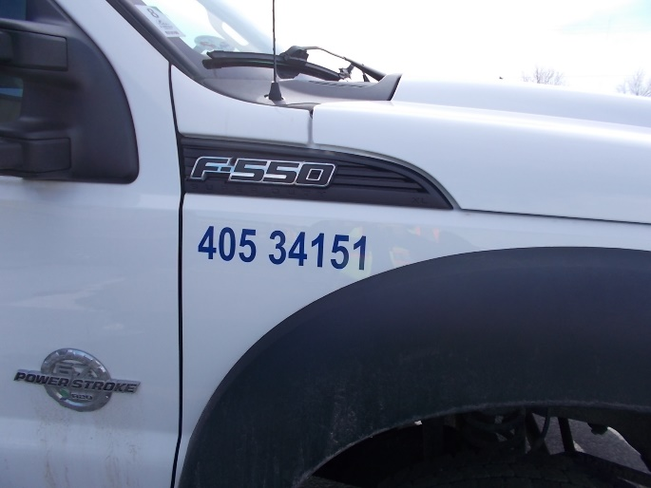
Commercial Motor Vehicle (CMV)
Used on a highway in interstate commerce
49 CFR Part 390 through part 396
Vehicle has a total weight capacity of >10,000 lbs.
Including capacity of any towed trailers
Driver Vehicle Inspection
Vehicle Maintenance
Medical Certification
Driver Qualification
Hours-of-Service
Notes:
For this discussion Examples F250, Chevy 2500, some Cargo Vans

Slide 15
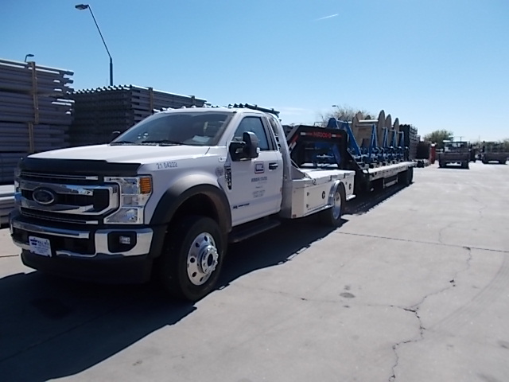
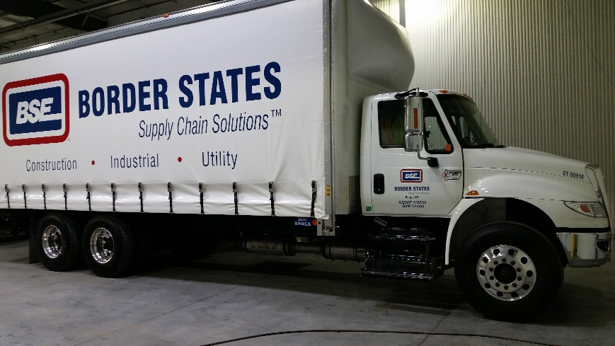
Commercial Drivers License (CDL)
49 CFR Part 40, 380, 382 and 383 Commercial Drivers License
Vehicle has a total weight capacity of >26,000 lbs.
Including capacity of any towed trailers

Slide 16
Commercial Motor Vehicle Groups

Slide 17
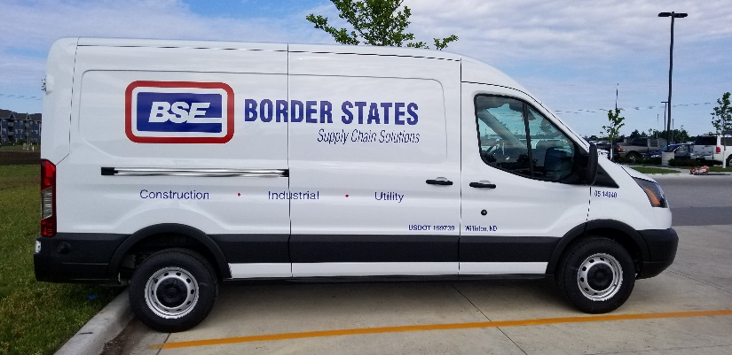
Intrastate or Interstate Commerce
Interstate or Intrastate?
If your vehicles cross state lines, or if your vehicles transport cargo or passengers that have or will cross state lines, you are an interstate carrier, subject to compliance with the Federal Motor Carrier Safety Regulations.
Notes:
The product or material you transport has more weight than the vehicle weight capacity when determining Interstate or Intrastate. This presentation will focus on Interstate drivers. Keller sells an 800-page document for each state's Intrastate requirements. Happy reading.
Questions on the vehicle group definitions????

Slide 18
ELDT before February 7, 2022
Entry-level driver is a driver with less than one year of experience operating a CMV with a CDL in interstate commerce.
All entry-level drivers who drive in interstate commerce and are subject to the CDL requirements must comply with the ELDT rules.

Slide 19
Required Training Before February
No set CDL curriculum – Many “CDL mills” set to provide minimum training.
Students obtain Commercial Learners Permit (CLP) before class begins
Training to pass a 75-point vehicle inspection
Training for straight line and 90-degree alley dock backing
Public road training to pass the CDL skills test
Employer verifies valid CDL and/or completes road test

Slide 20
Required Training Before February
In addition, Entry-level driver training is the training the CDL driver receives in the driver qualification(DQ) requirements.
Hours of service of drivers
Driver wellness
Whistleblower protection
Coercion of Drivers

Slide 21
Certificate of Completion

Slide 22
Driver Qualification File Documents
NH-5 Record of Violations
NH-4.1 – NH-4.4 Driver Application
Release of Information Form – D&A Testing History and Driver’s Accident History (CDL driver only)
NH-11 GAP in Time (CDL driver only)
NH-3 Release & Documentation of Pre-employment Testing
NH-6 Hours of Service
NH-9 Certificate of License
Driver Certification for Other Compensated Work
NH-8 Driver Drug & Alcohol Policy
Limited Clearinghouse Consent (CDL driver only)
NH-7 Road Test
Signed FMCSR receipt (1st page from Federal Motor Carrier Safety Regulations pocketbook-little green book)

Slide 23
There's a Problem With How We Train Truckers
TIME BY ALANA SEMUELS
In most states, aspiring barbers have to spend 1,000 hours or more in training before they get a license. To drive a 40,000-pound truck, though, there’s no minimum behind-the-wheel driving time required, no proof of ability to navigate through mountains, snow, or rain.
There’s just a medical exam, a multiple-choice written exam, and a brief driving test—which in some states can be administered by the school that drivers paid to train them.
Notes:
Alana in a Time article made an interesting observation.

Slide 24
Colorado Driver Example
On April 25, 2019, a deadly traffic collision occurred on Interstate 70 near Lakewood, Colorado, United States, when a semi-trailer truck's brakes malfunctioned, causing the truck to crash into 12 cars and three other semi-trailer trucks, resulting in multiple fires and explosions, killing four people.

Slide 25
Colorado Driver Example
There was a large emphasis that Aguilera-Mederos was not properly trained during the trial. The company he worked for, Castellano 03 Trucking, had a higher-than-average rate of vehicle issues.

Slide 26
Colorado Driver Example
Castellano 03 Trucking LLC was dissolved months after the fatal crash. However, Newsweek reported that Volt Trucking LLC was registered as a business one day after the fatal crash by the same owner.

Slide 27
ELDT After February 7, 2022
FMCSA established a Federal standard for mandatory training of entry-level drivers
Establishes minimum requirements entry-level driver training providers must meet
Established need for the Training Provider Registry

Slide 28
Commercial Vehicle Training Association
Fleets should benefit from the higher standards because the main FMCSA goals were to standardize training across the nation, lower fatalities and eliminate “CDL mills,” which poorly prepared drivers with only a few days of training, according to Bailey Wood, CEO of CVTA.

Slide 29
Who is Considered Entry Level?
Anyone obtaining a Class A CDL or Class B CDL for the first time;
Anyone upgrading an existing Class B CDL to a Class A CDL;
Anyone obtaining a school bus (S), passenger (P), or hazardous materials (H) endorsement for the first time.

Slide 30
ELDT Requirements
Two components of ELDT
Theory Instruction
First time endorsements only require theory training.
Behind the Wheel instruction (BTW)
Range
Roadway

Slide 31
Trainer Provider Requirements
Follow a curriculum that meets the applicable criteria set forth in appendices A through F of Part 380
Appendix A – Class A CDL Training Curriculum
Appendix B – Class B CDL Training Curriculum
Appendix C – Passenger Endorsement Training Curriculum
Appendix D – School Bus Endorsement Training Curriculum
Appendix E – Hazardous Materials Endorsement Training Curriculum
Appendix F – LCV Driver Training Curriculum
No Set Time Requirements – must pass all written test with 80% average and pass the State road test.

Slide 32
Appendix A Required Curriculum
Theory Instruction
Basic Operation
Orientation
Control Systems/Dashboards
Pre- and Post-Trip Inspections
Basic Control
Shifting/Operating Transmissions
Backing and Docking
Coupling and Uncoupling

Slide 33
Appendix A Required Curriculum
Theory Instruction
Safe Operating Procedures
Visual Search
Communication
Distracted Driving
Speed Management
Space Management
Night Operations
Extreme Driving Conditions

Slide 34
Appendix A Required Curriculum
Theory Instruction
Advanced Operating Practices
Hazard Perception
Skid Control/Recovery, Jackknife
Railroad-Highway Grade Crossings

Slide 35
Appendix A Required Curriculum
Theory Instruction
Vehicle Systems and Reporting Malfunctions
Identification and reporting of Malfunctions
Roadside Inspections
Vehicle Maintenance

Slide 36
Appendix A Required Curriculum
Theory Instruction
Non-Driving Activities
Handling and Documenting Cargo
Environmental Compliance Issues
Hours of Service Requirements
Fatigue and Wellness Awareness
Post Crash Procedures
External Communications
Whistleblower/Coercion
Trip Planning
Drugs and Alcohol
Medical Requirements

Slide 37
Appendix A Required Curriculum
Behind-the-Wheel – Range
Vehicle Inspection Pre-Trip / Enroute / Post-Trip
Driver Vehicle Inspection Reports (DVIR)
Straight Line Backing
Alley Dock Backing (45 / 90 Degree)
Off-Set Backing
Parallel Parking Blind Side
Parallel Parking Sight Side
Coupling and Uncoupling

Slide 38
Appendix A Required Curriculum
Behind-the-Wheel - Public Roadway
Vehicle Controls Including
Left Turns
Right Turns
Lane Changes
Curves at Highway Speed
Entry or Exit on the Interstate or Controlled Access Highway

Slide 39
Appendix A Required Curriculum
Behind-the-Wheel - Public Roadway
Shifting/Transmissions
Communicating Signaling
Visual Search
Speed and Space Management
Safe Driver Behavior
Hours of Service
Hazard Perception
Railroad-Highway Grade Crossings
Night Operations
Extreme Driving Conditions
Skid Control/Recovery, Jackknife Prevention
Notes:
Automatic restriction removal

Slide 40
Appendix A Required Curriculum
With a projected student to instructor ratio of 4:1 it is estimated at 200 hours to complete this new standard curriculum and skills training – JJ Keller.

Slide 41
SAGE Truck Driving Schools
TTD150 (Tractor-Trailer 150 Hours) Beginner Course - Designed for students to obtain their Class A Certificate Program
This program is designed for individuals with little or no experience driving a commercial vehicle. It consists of 102 hours of online learning, class and lab time and 48 hours of driving including the State CDL Exam. It meets the Federal Motor Carrier Safety Administration (FMCSA) Entry Level Driver Training (ELDT) requirements. The program takes approximately 5 weeks to complete.

Slide 42
SAGE Truck Driving Schools
TTD2150 (Tractor-Trailer 150 Hours) Essentials Course - Designed for students to obtain their Class A Certificate Program
This program is designed for individuals with little or no experience driving a commercial vehicle. It consists of 102 hours of online learning, class and lab time and 34 hours of driving including the State CDL Exam. It meets the Federal Motor Carrier Safety Administration (FMCSA) Entry Level Driver Training (ELDT) requirements. The program takes approximately 4 weeks to complete.

Slide 43
SAGE Truck Driving Schools
TTD80 (Tractor-Trailer 80 Hours) Essentials Course - Designed for students to obtain their Class A Certificate Program
This program is designed for individuals with driving experience in a commercial vehicle. It consists of 50 hours of online learning, class and lab time and 32 hours of driving including the State CDL Exam. It meets the Federal Motor Carrier Safety Administration (FMCSA) Entry Level Driver Training (ELDT) requirements. The program takes approximately 4-5 weeks to complete.

Slide 44
SAGE Truck Driving Schools
Class B Straight Truck (Straight Truck 28 Hours) Beginner Course - Designed for students to obtain their Class B
This program is designed for individuals with little or no experience driving a commercial vehicle. It consists of 12 hours of online learning, class and lab time and 16 hours of driving including the State CDL Exam. It meets the Federal Motor Carrier Safety Administration (FMCSA) Entry Level Driver Training (ELDT) requirements. The program takes approximately 3-4 weeks to complete.

Slide 45
Notes:
Different approaches, all more in-depth than the previous CDL mills.

Slide 46
Trainer Provider Requirements
Utilize a facility that meets the criteria set forth in 380.79
Training providers classroom and range facility must comply with all applicable Federal, State and/or local statues and regulations.

Slide 47
Trainer Provider Requirements
Utilize vehicles that meet the criteria set forth in 380.71
All vehicles used in the behind-the-wheel training must comply with all applicable Federal and State safety requirements
Training vehicles must be in the group and type that driver-trainees intend to operate for their CDL skills test

Slide 48
Trainer Provider Requirements
Utilize driver training instructors that meet the criteria set forth in 380.713
Behind-the-Wheel (BTW) Instructor
Holds CDL and Endorsements to operate training vehicle
Has at least 2-years of experience driving or training
Meets all applicable State qualifications requirements for CMV instructors
Prohibited from training for 2 years if CDL has been cancelled, suspended or revoked for any of the disqualifying offenses identified in 383.51

Slide 49
Disqualification of Drivers (383.51)
If an employer knows, or reasonably should know, that a driver is disqualified, it must not allow the disqualified driver to operate a CMV. See 49 CFR 383.37. The disqualification period of a driver is determined by the offense and the driver’s record of prior convictions. There are separate disqualification tables for the following types of offenses in 49 CFR 383.51: major offenses, serious offenses, railroad-highway grade crossing offenses, and violations of out-of-service orders. Major and serious offenses require driver disqualification even if the CDL holder is driving a non-CMV.

Slide 50
Disqualification of Drivers (383.51)
Major offenses require a minimum disqualification of one year and include the following:
Driving under the influence of alcohol as prescribed by State law.
Driving under the influence of a controlled substance.
Having an alcohol concentration of .04 or greater while operating a CMV.
Refusing to take an alcohol test as required by implied consent laws or regulations.
Leaving the scene of an accident.
Using the vehicle to commit a felony.
Driving a CMV while revoked, suspended, canceled or disqualified as a result of prior violations committed while operating a CMV.
Causing a fatality through the negligent operation of a CMV.
Using the vehicle in the commission of a felony involving the manufacturing, distributing, or dispensing of a controlled substance (mandatory lifetime disqualification).
Notes:
Driving while disqualified

Slide 51
Disqualification of Drivers (383.51)
Serious offenses require a minimum disqualification of 60 days and include the following:
Speeding excessively (15 mph or more over the speed limit).
Driving recklessly.
Making improper or erratic traffic lane changes.
Following the vehicle ahead too closely.
Driving a CMV without a CLP or CDL
Violating a State texting or handheld cell use while driving.
Notes:
It is the serious offenses that require more thought.

Slide 52
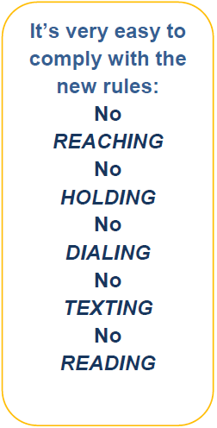
Mobile Phone Restrictions
Notes:
Very difficult for today's drivers

Slide 53
Trainer Provider Requirements
Utilize driver training instructors that meet the criteria set forth in 380.713
Theory Instructor
Holds CDL and Endorsements to operate training vehicle
Has at least 2-years of experience driving or training
Meets all applicable State qualifications requirements for CMV instructors
OR previous meet these requirements
Prohibited from training for 2 years if CDL has been cancelled, suspended or revoked for any of the disqualifying offenses identified in 383.51

Slide 54
Trainer Provider Requirements
Be licensed, certified, registered to provide training in accordance with the laws and regulations of any State where training is conducted.
States testing agencies are required to report non-compliance with FMCSA – ELDT or minimum state training requirements.

Slide 55
Trainer Provider Requirements
Allow FMCSA or its authorized representatives to audit or investigate the training provider’s operations to ensure that the provider meets the criteria set forth in this section.

Slide 56
Trainer Provider Requirements
Electronically transmit an Entry-Level Driver Training Provider Registration Form through the TPR Web site, which attests that the training provider meets this section, to obtain a unique TPR number for each training location.

Slide 57
Training Provider Registry
FMCSA web system
Contains the official list of all entities registered with FMCSA.
Self certify they meet all the requirements for being an entry-level training provider
Retain a record of which drivers have successfully completed entry-level driver training for State licensing agency.es to access

Slide 58
Training Assessments
Training providers must use written assessments to determine driver-trainees proficiency in the knowledge objectives in the theory portion of each unit of instruction.
Must achieve a minimum test score of 80 percent (total curriculum average)
Training instructors must evaluate and document a driver-trainees’ proficiency in BTW skills .

Slide 59
Training Certification
After an individual completes training, provider must, by midnight of the second business day after the driver trainee completes the training, electronically transmit training certification information through TPR Web site

Slide 60
Training Certification
Certification Information
Driver Name – License and/or CLP number and issuing State.
Commercial Drivers License Class, Endorsements.
Type of training completed
Total number of clock hours the driver-trainee spent to complete the BTW training
Name of Training Provider and unique TRP ID number
Date(s) of successful training completion
Note: some States have minimum training hour requirements

Slide 61
ELDT Requirements
An Entry Level Driver must have a certificate of completion on the National Provider Registry before they will be allowed to complete the CDL Skills test or issued a license endorsement.

Slide 62
Continued TPR Registry Listing
Meet the Requirements 380.703
Bi-annually update on the TPR registry (each location)
Report any changes to key information within 30-days
Maintain Required State Licensure, Registration or Certification
Allow an audit or investigation of the training provider
Ensure all required documentation is available to FMCSA upon request. Provider has 48-hours to submit requested documents.
Notes:
Questions regarding the differences between the old and new requirements????

Slide 63
Implied Training for Non-CDL, CMV
Part 390 FMCSA Regulations General
390.3T(2) Every driver and employee shall be instructed regarding and comply with all applicable regulations …
Can you verify that the driver understands the regulations that apply to them?

Slide 64
Implied Training for Non-CDL
Part 391.11 General Qualifications of Drivers
(3) Can by reason of experience, training or both, safely operate the type of commercial motor vehicle they will operate.
(8) Has successfully completed a drivers road test.
Drivers must successfully demonstrate their safe operation of a non-CDL CMV.

Slide 65
Implied Training for Non-CDL
Part 393 Subpart I – Protection Against Shifting and Falling Cargo
(b) Each commercial motor vehicle must…be loaded, equipped and the cargo secured… to prevent the cargo from leaking, spilling, blowing or falling from the motor vehicle.

Slide 66
Implied Training for Non-CDL
Part 393 Subpart I – Protection Against Shifting and Falling Cargo
( c) Cargo must be contained, immobilized or secured…to prevent shifting upon or within the vehicle to such an extent that the vehicle’s stability or maneuverability is adversely affected.
Is the driver familiar with the North American Cargo Securement Standard.

Slide 67
Training for Non-CDL Summary
Can you confirm through the road test and/or documented training that this driver can:
Identify and apply the regulations for their vehicle operating class
Properly inspect the vehicle for safety related defects
Safely operate the vehicle
Safely load and secure all cargo
Notes:
Put it all together
FMCSA showed what it considers as the minimum level of training for these areas
???

Slide 68
Border States Training Stages Plan
Initial
Federal Motor Carrier Safety Administration (FMSCA) Regulations
National Safety Council - Professional Truck Driver Training
Vehicle System Identification and Inspection Training
Cargo Securement and Vehicle Weights Training (Bridge Laws)
Hazardous Materials
Challenging Driving Conditions
Lytx / DriveCam (video event recorder)
Acceptable Driver Criteria (Driver scoreboard)
Distracted Driving Policy
Drug and Alcohol Testing
CyntrX Electronic Log Device and Driver Vehicle Inspection Training
Driver Supervisor / Mentor Training

Slide 69
Border States Training Stages Plan
Transitional
National Registered School for CDL training with Border States driver mentor or
Initial Training for Commercial – Non CDL
Ongoing
15-minute training modules from Initial training

Slide 70
Border States Training Stages
Remedial / Corrective
National Safety Council training with certified trainers
Professional Truck Driver Training
Attitudinal Dynamics of Driving
Distracted Driving
Ride along training with a certified trainer

Slide 71
Retile Theory and Nuclear Verdicts
The Reptile Theory, published in 2009 and currently sold on amazon for $1,195.00 / copy, is the plaintiff’s guidebook on how to successfully attack transportation companies for a massive settlement in serious injury or fatality vehicle collisions.
Notes:
Why train?

Slide 72
Reptile Theory
The Reptile Theory is based on the human need for survival and self-preservation. The Reptile Theory book shows a plaintiff what metrics to look for and how to obtain the big data that most transportation companies overlook, what the Reptile Theory calls Vectors. These Vectors can expose systemic faults within the company’s safety operating procedures or practices. Once discovered the plaintiff will use a systemic failure to convince the jury that the survival and self-preservation of the public is at risk, and they must respond (fight or flight) with a resounding message to the defendants in the form of huge punitive damage settlements.

Slide 73
Reptile Theory
Once the systemic failure and the need for survival have been established, the facts of the current accident become irrelevant. Human’s primal need for survival will overpower their want for logical justice every time. Defendants who prepare their defense based solely on the facts of the accident are resoundingly defeated by the plaintiffs Retile Theory attack.

Slide 74
Vectors to Trouble
Litigation Attorneys will attack key areas in a fatality or serious injury truck collision regardless of who was originally at fault to prove that the company was negligent.
Are there discrepancies in the driver’s onboarding files – was the driver qualified to be hired?
Are there discrepancies in the driver’s qualification files – is this driver qualified to drive?
Do you have a systematic vehicle maintenance and repair program? Are you following the program?
Is this driver subject to an Hours-of-Service regulation – Is this driver in compliance with the Hours of Service in their Record of Duty.
Was the driver adequately trained on the vehicle they are operating and the cargo they are moving? Is training and / or road test documentation available?

Slide 75
Vectors to Trouble
Can the litigators prove -
Negligent entrustment is a cause of action in tort law that arises where one party (the entrustor) is held liable for negligence because they negligently provided another party (the entrustee) with a dangerous instrumentality, and the entrusted party caused injury to a third party with that instrumentality.
Negligent supervision is when someone who has a legal responsibility to supervise others fails to do so in a responsible manner.
Negligent retention is a type of employment claim in which a worker claims that their employer failed to terminate or discharge an employee who should have been released from the company.

Slide 76
Recent Supreme Court Action
Plaintiff claimed a broker negligently hired a carrier that was involved in a personal injury accident.
Broker argued that it must rely on FMCSA certification, or it would face various State negligence standards.
Supreme court left the final decision stand
FMCSA regulations are the minimum standard.

Slide 77
Recent Supreme Court Action
You have an obligation to
Review your carriers CSA metrics
Use carriers with below average scores
If you are the carrier with above average scores, it is time to improve.
Most improvements start with training

Slide 78
Questions

